Slide 1


🏗 Reliant Windows – ERP/CRM Prototype with AI Support
A demonstration of AI-powered business automation
Panel
Dean Stanford
Mark Hilsdon
Nouh Elmitwally
Essa Shahra
Samer Bamansoor
Natalie Lewis
Presented By
Naga Sri Ram Kochetti
Date: 7th October 2025

Slide 2







Executive Summary
Reliant Windows currently manages quotations and customers manually. This prototype demonstrates a cloud-ready ERP/CRM system with AI support to transform their business operations.
Automate Workflows
Reduce Manual Errors
Streamline quotations, customer management, and product handling
Eliminate inconsistencies from manual data entry
AI-Powered Decisions
Enable better decision-making with intelligent insights

Slide 3

Business Challenges
Reliant Windows faces significant operational inefficiencies that impact productivity and customer service quality.
Manual Quotation Preparation
Time-consuming and inconsistent processes lead to delays and pricing variations
Spreadsheet Customer Data
No central view of customer information creates fragmented relationships
No Standard Pricing
Lack of consistent pricing methodology affects profitability
Limited Management Insights
Managers have no visibility into sales activity and performance metrics

Slide 4

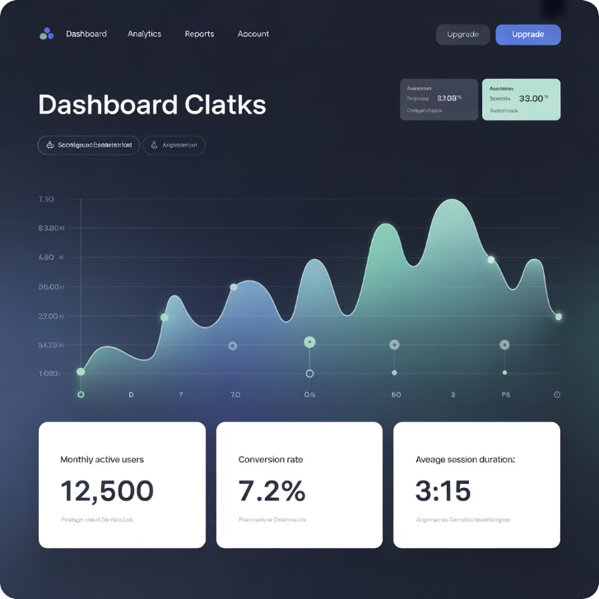
Proposed Solution
Our ERP/CRM prototype leverages modern technology stack with AI-powered assistance to transform business operations.
Core Features
Modern stack ERP/CRM prototype
Role-based access (Manager vs Sales)
Portable, simple stack (Flask + SQLite)
AI-Powered Assistance
Price prediction engine using Linear Regression
Quote summary generator with Transformers NLP

Slide 5
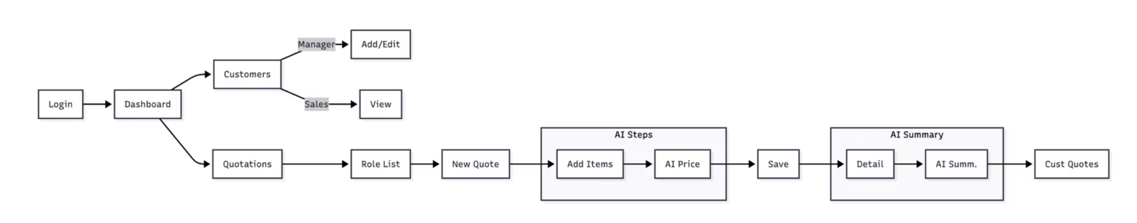
Workflow Comparison
As-Is (Manual)
To-Be (With Prototype)
Sales reps prepare quotes in Excel
Web-based quotation & customer management
No AI support → pricing inconsistent
AI Price Suggestion during quote creation
No central customer history
AI Summaries for professional documentation
Centralized database with role-based access

Slide 6





System Architecture
Our solution follows a modern, scalable architecture designed for efficiency and maintainability.
Client (Browser)
Login, Dashboard, Customers, Quotations interface
Flask Web App
Routes, Templates (Bootstrap), Role-based access, API for AI features
SQLite Database
Users, Customers, Products, Quotations, Items storage
AI Layer
Price Predictor (scikit-learn), Summary Generator (Transformers)

Slide 7










Database Schema
The database design ensures data integrity and supports complex business relationships.
Customer
User
Linked to many quotations for relationship tracking
Manager and Sales roles with different permissions
Product
Used in quotation items with specifications
Quotation Item
Line-level detail with dimensions and pricing
Quotation
Contains multiple items with AI-generated summaries

Slide 8

AI Components
Our AI-powered features provide intelligent assistance for pricing and documentation.
Price Predictor
Technology: scikit-learn Linear Regression
Input: Category, dimensions, quantity, base cost
Output: AI-suggested total price trained on seeded quotation data
Quote Summary Generator
Technology: Hugging Face Transformers (t5-small / distilBART)
Input: Customer and quotation items
Fallback: Template-based summary for reliability

Slide 9
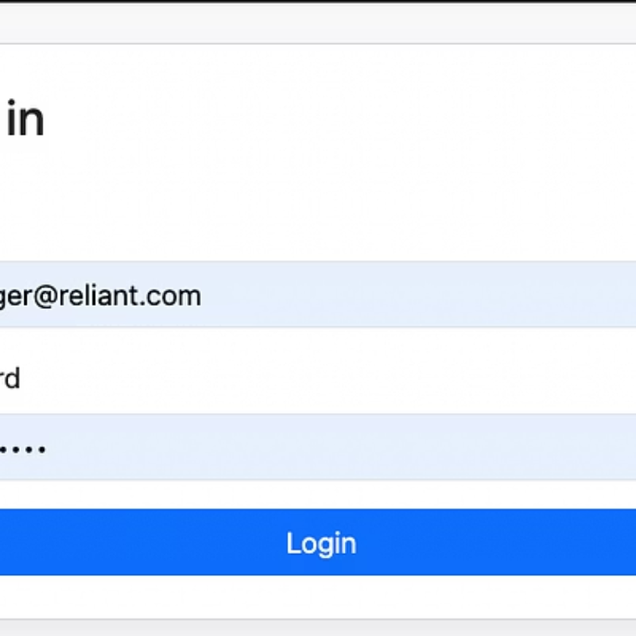
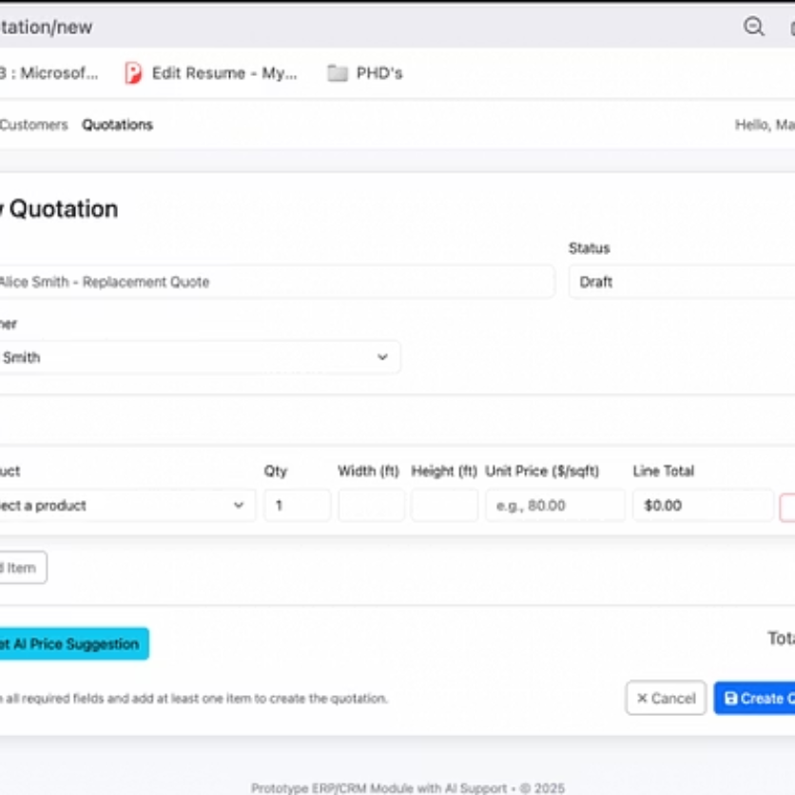
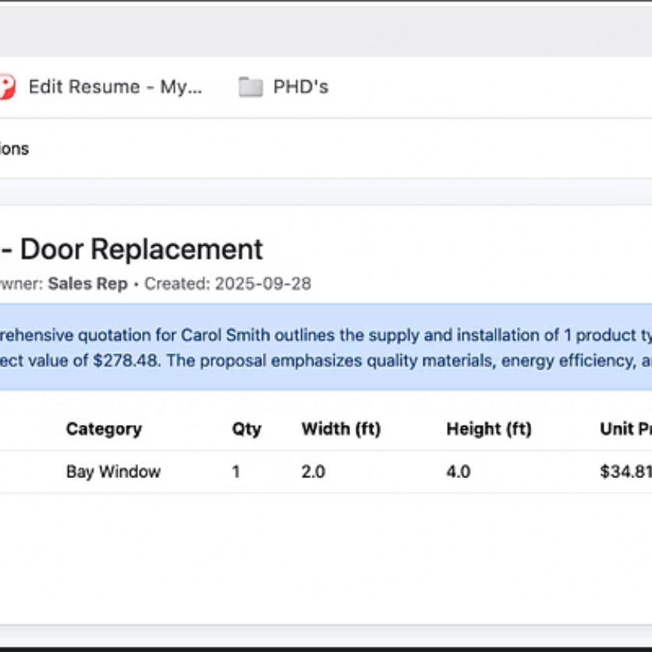
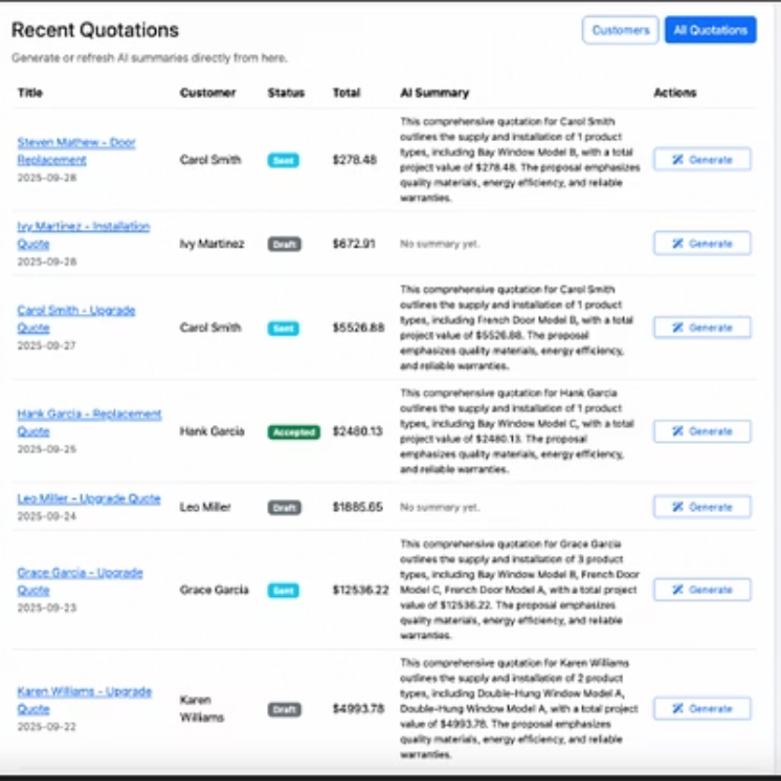
Demo Highlights
Experience the power of AI-driven business automation through our interactive demonstration.
01
02
Login System
Customer Management
Role-based access for Manager and Sales users
Create and manage customers (Manager only)
03
04
Smart Quotations
Dynamic Dashboard
Add items with dimensions, get AI price suggestions, auto-generate summaries
Real-time summaries with on-demand refresh capability

Slide 10



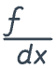

Future Recommendations
Strategic roadmap for scaling the prototype into a production-ready enterprise solution.
Cloud Deployment
Migrate from SQLite to PostgreSQL with Docker containerization for scalability
Enhanced AI Capabilities
Expand AI models for customer segmentation and sales forecasting analytics
System Integration
Connect with accounting and invoicing systems for complete business workflow
Production Features
Implement audit logs, multi-user authentication, and performance monitoring
✨ Thank You
Questions and discussion welcome

